Slide 1
Amdt revAMP REPORT
DONE BY THIHAN GAMAGE

Slide 2
Acknowledgment
I hereby would like to thank, AMDT and lecturers for the resources and teaching required skills and assistng me. My parents for providing with necessary resources. My friends for the support to make this project a success.

Slide 3
Content
Tools Used For Web Development 4
Wireframes 8
Usabillity Principles Used 14
Final Outcome 20

Slide 4
Tools used for web development

Slide 5

Visual Studio Code
I used visual studio code to create my website.
Visual Studio Code is a free source code editor made by Microsoft for Windows, Linux and macOS. Features include support for debugging, syntax highlighting, inteligent code completion, snippets, code refactoring, and embedded GIT.

Slide 6

Github
GitHub is a web improvement stage enlivened by the manner in which you work. This apparatus permits engineers to audit code, oversee ventures, and manufacture programming.
Features:
Facilitate effectively, remain adjusted, and complete GitHub's undertaking the executives instruments
It extends to right instruments for the employment opportunity
Simple documentation close by quality coding
Developers can host their documentation directly from repositories

Slide 7

Bootstrap
Bootstrap is a free and open-source CSS system coordinated at responsive, portable first front-end web advancement. It contains CSS-and (alternatively) JavaScript-based plan formats for typography,forms, buttons, navigation and other interface parts.
Bootstrap is the seventh-most-featured venture on GitHub, with in excess of 142,000 stars, behind freeCodeCamp (right around 312,000 stars) and possibly behind Vue.js system. As per Alexa Rank, Bootstrap is in the best 2000 in the USA while vuejs.org is in the best 7000 in the USA

Slide 8
WIREFRAMES

Slide 9
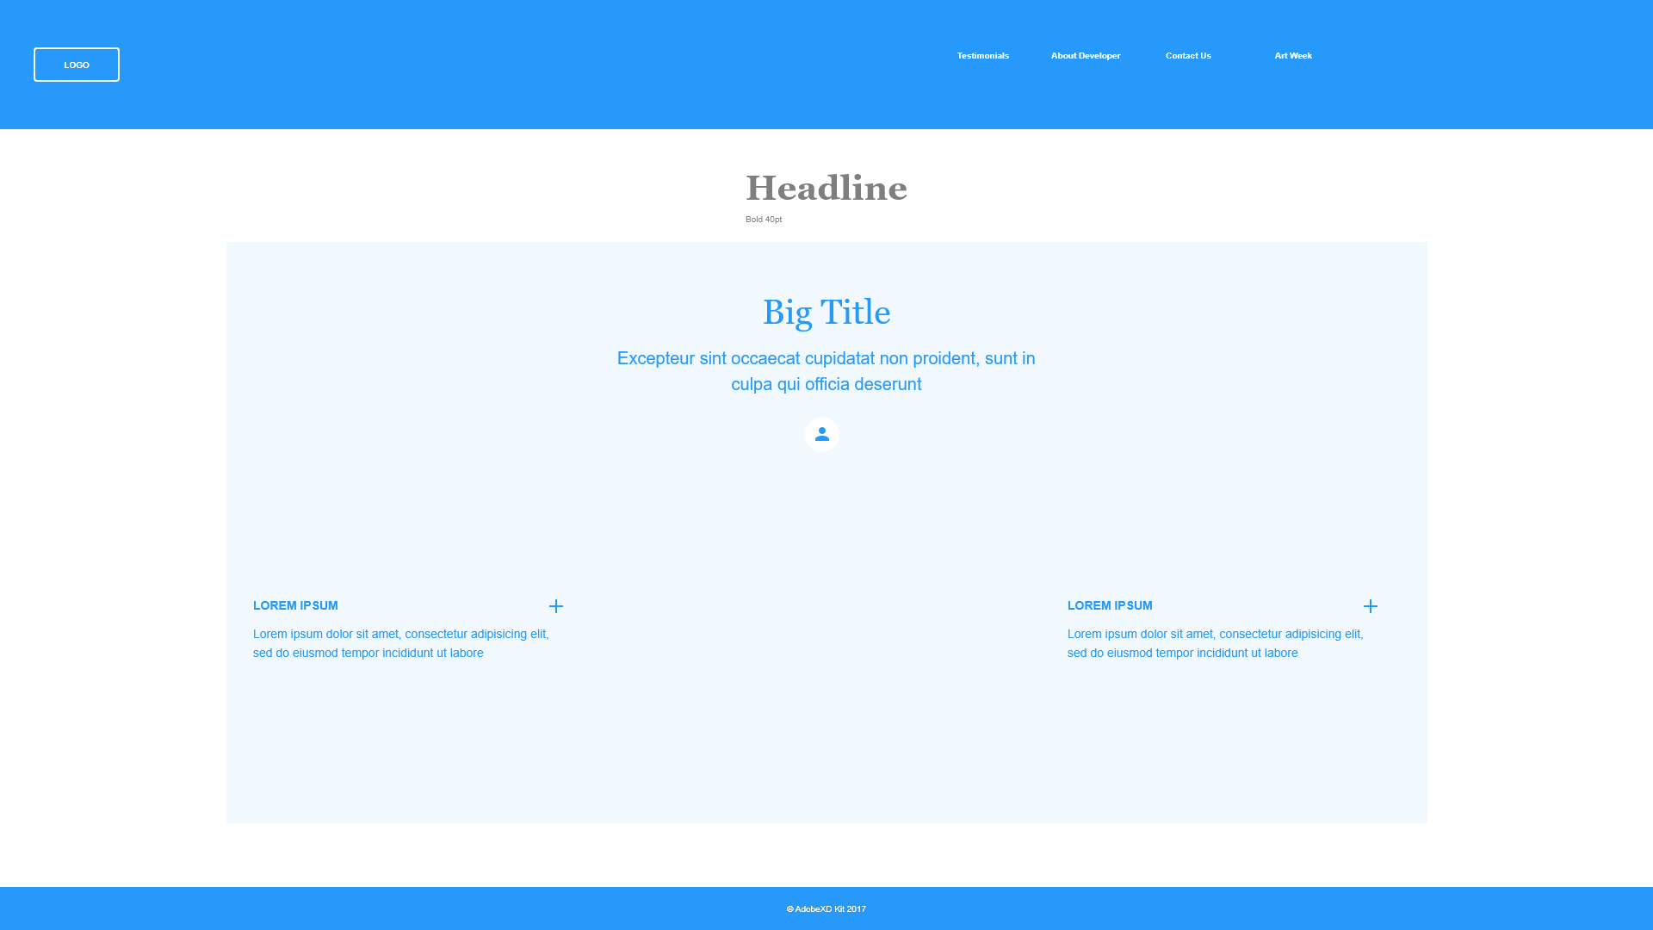
Landing Page

Slide 10
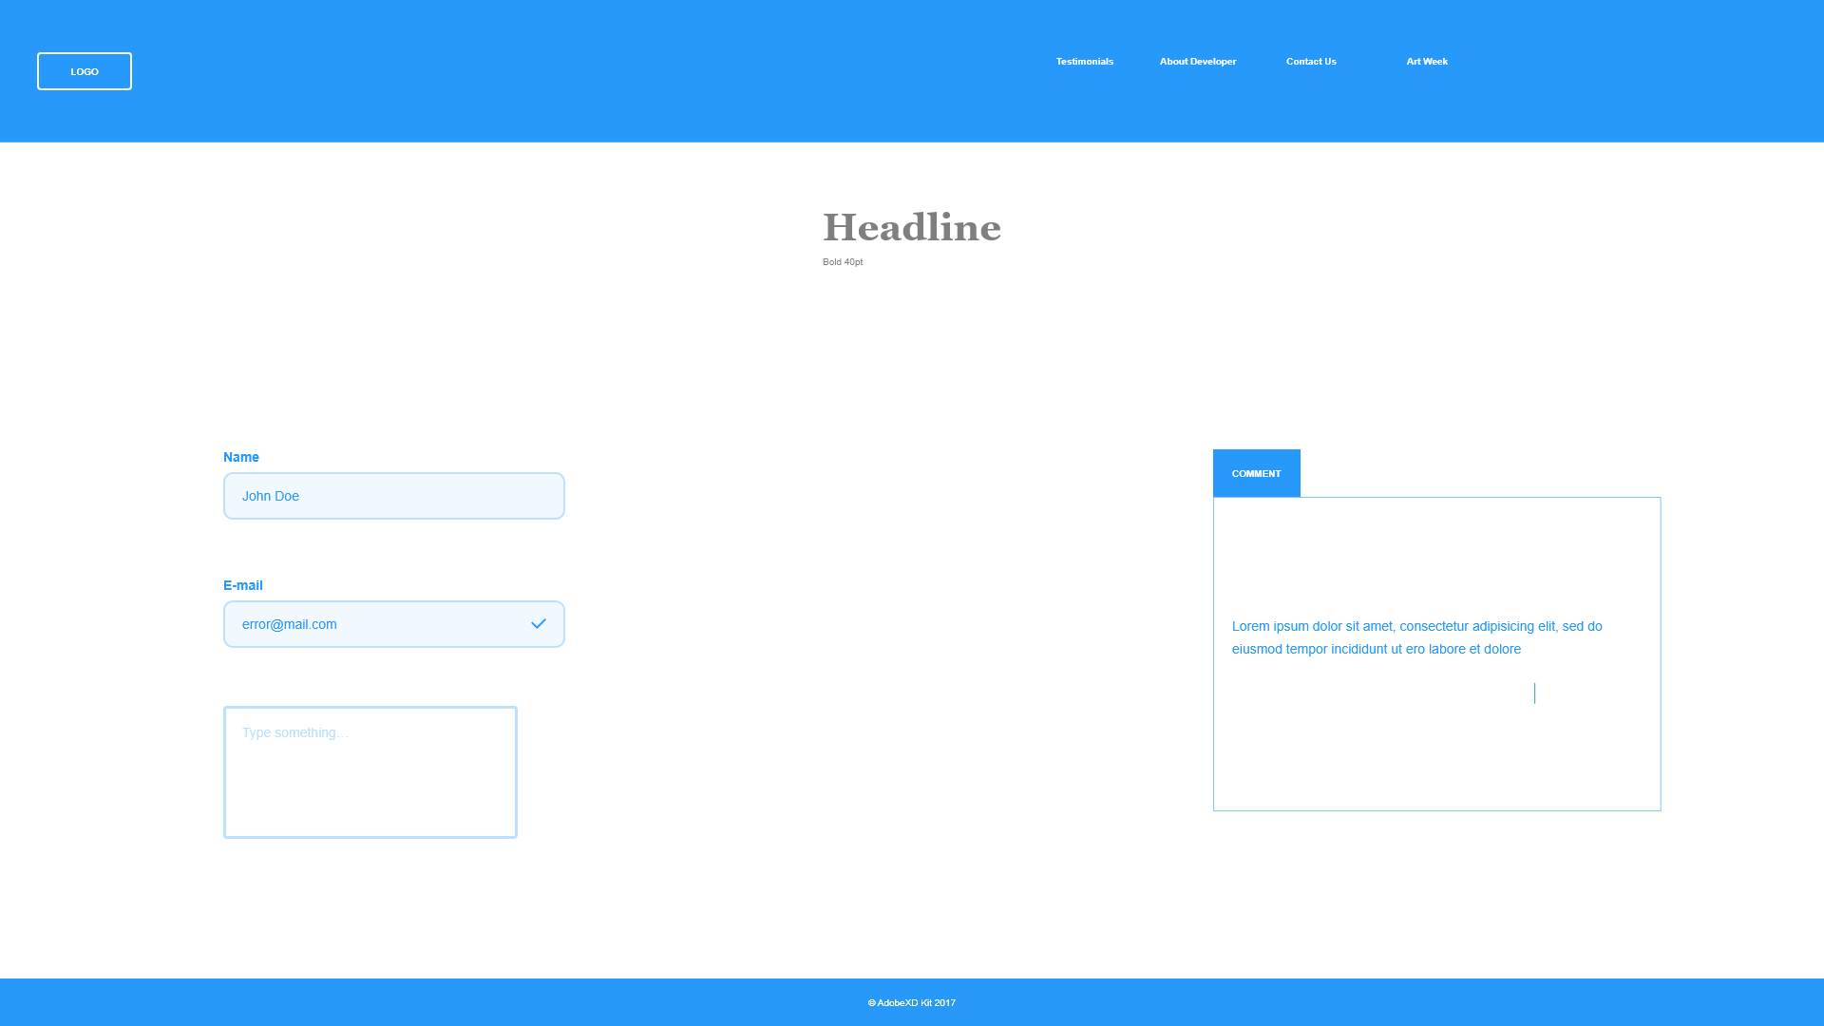
Testimonials Page

Slide 11
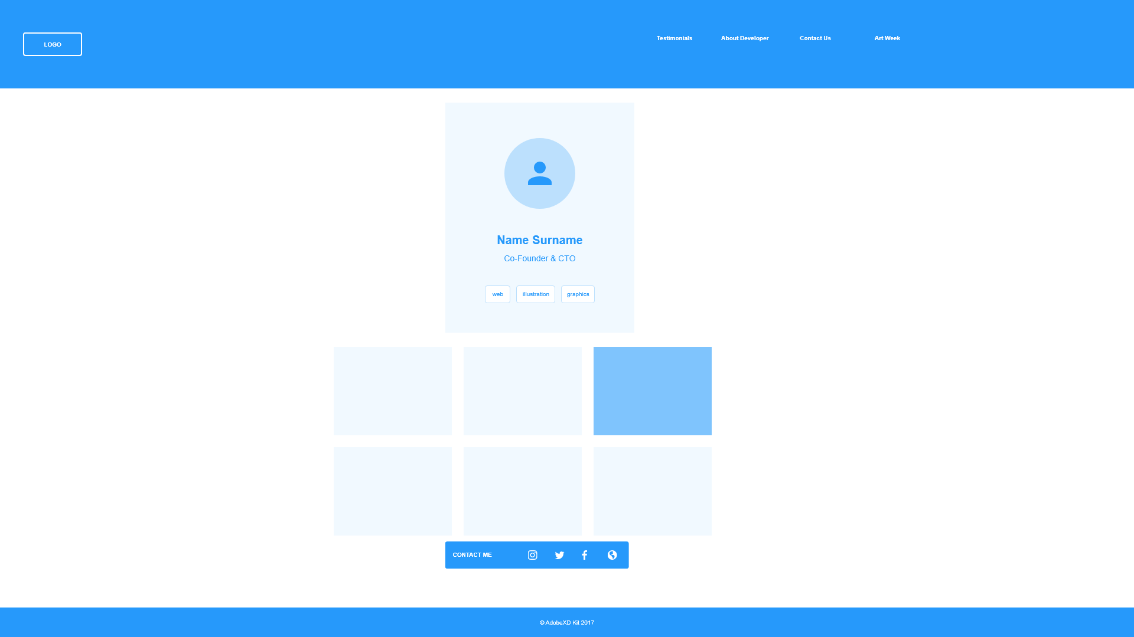
About Developer Page

Slide 12
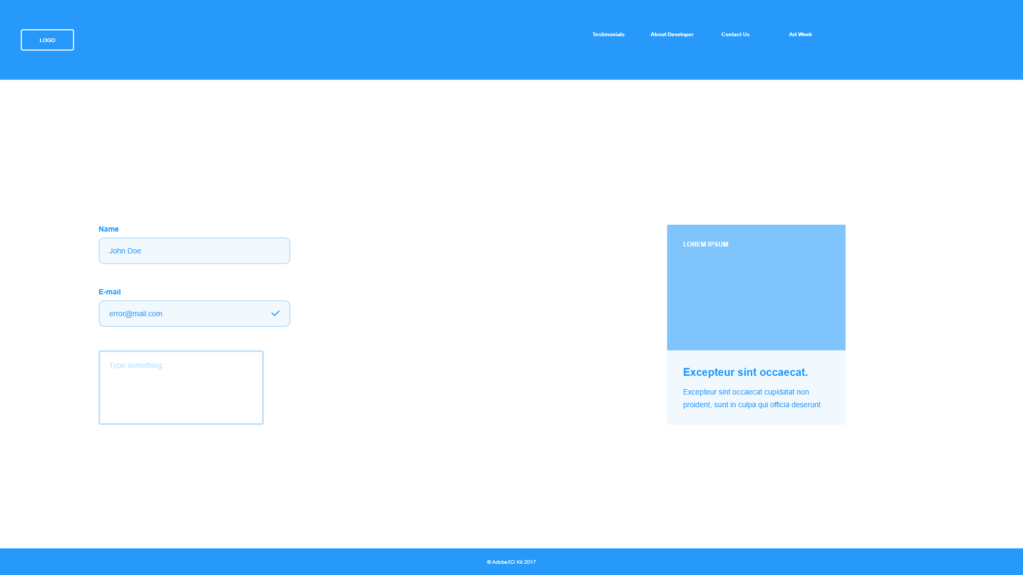
Contact Us Page

Slide 13
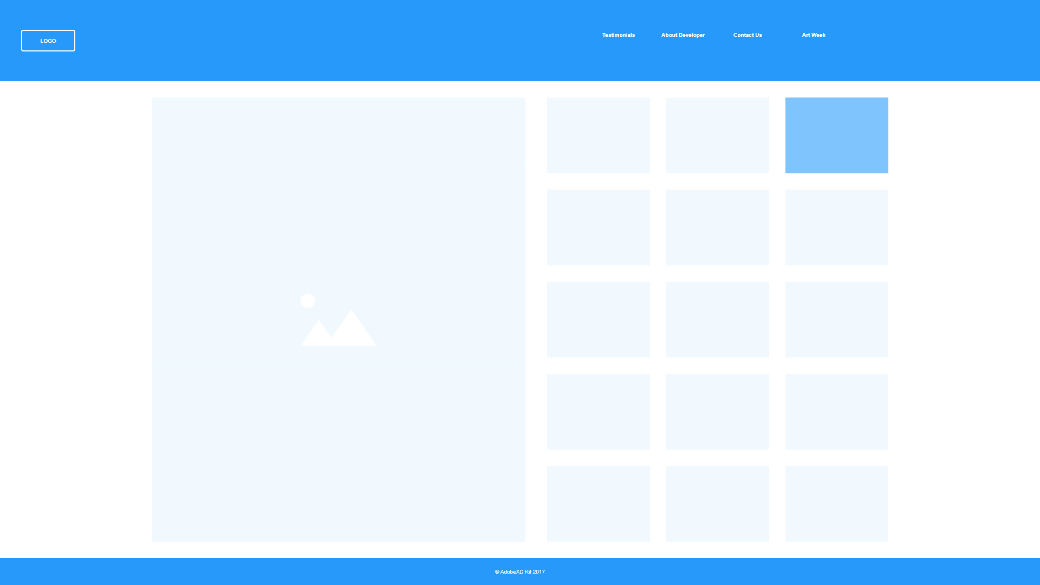
Art Week Page

Slide 14
Usability Principles I Have Used

Slide 15
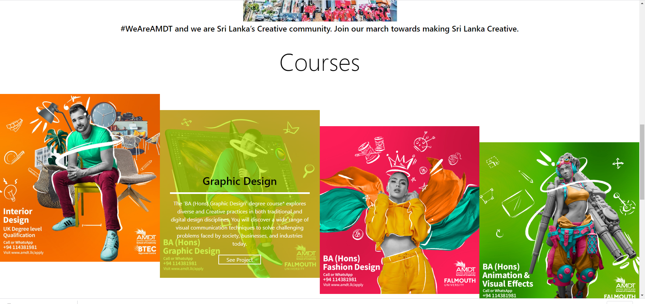
Visibility of system status
The visibility of system status alludes to how well the condition of the system is passed on to its clients. Preferably, systems ought to consistently keep clients educated about what is happening, through fitting criticism inside sensible time.
The Website always keeps users informed about what is going on through feedbacks within short time.
Only relevant data is displayed

Slide 16
Aesthetic and minimalist design
Exchanges ought not contain data which is unessential or once in a while required. Each additional unit of data in an exchange rivals the important units of data and decreases their relative visibility.

Slide 17
Recognition rather than recall
Limit the client's memory load by making items, activities, and choices noticeable. The client ought not need to recollect data starting with one piece of the discourse then onto the next. Guidelines for utilization of the system ought to be noticeable or effectively retrievable at whatever point suitable.

Slide 18
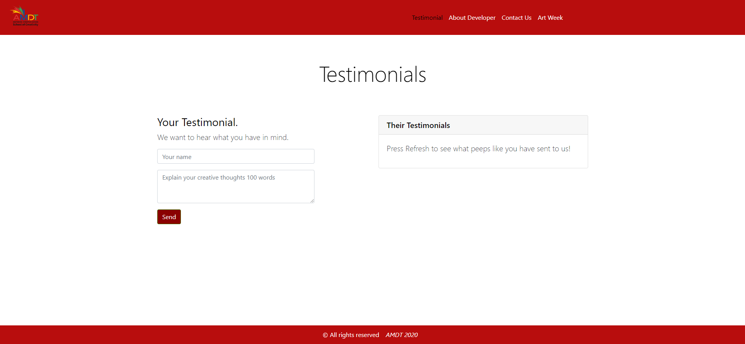
Match between system and the real world
The system ought to communicate in the clients' language, with words, expressions and ideas natural to the client, instead of system-situated terms. Follow genuine shows, causing data to show up in a characteristic and consistent request.
So basically the site is built for anyone who understands english.
Everything is in simple english

Slide 19
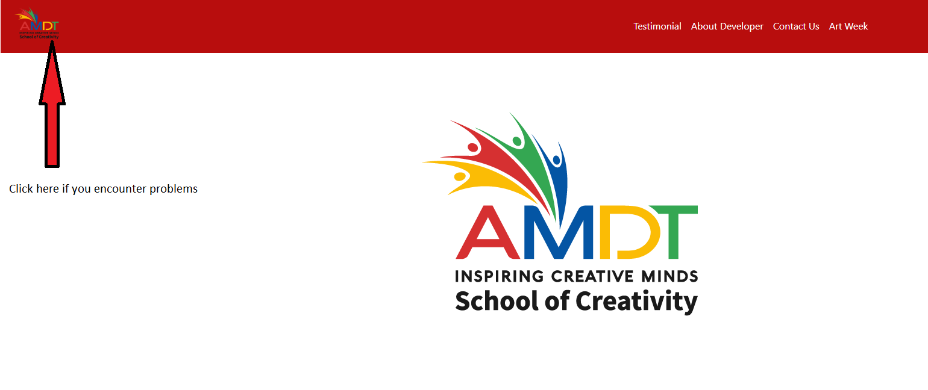
User control and freedom
Clients often pick system works accidentally and will require an unmistakably checked "crisis exit" to leave the undesirable state without experiencing an all-encompassing exchange. Backing fix and re-try.
So if you encounter a problem clicking on amdt logo in the navigation bar will put you back to the homepage.

Slide 20
Final Outcome

Slide 21
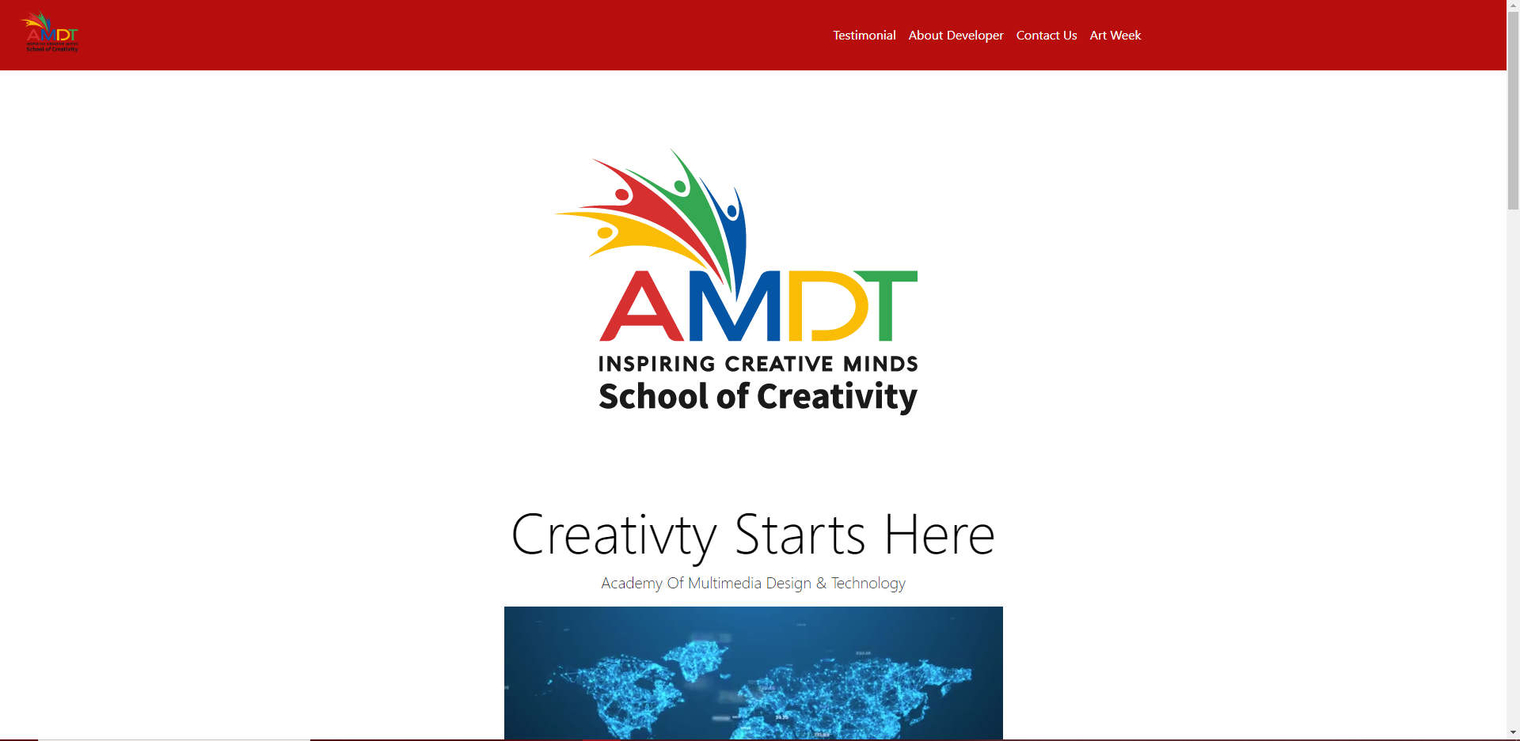
Landing Page
This is the homepage for the website, where you can access your needs.

Slide 22
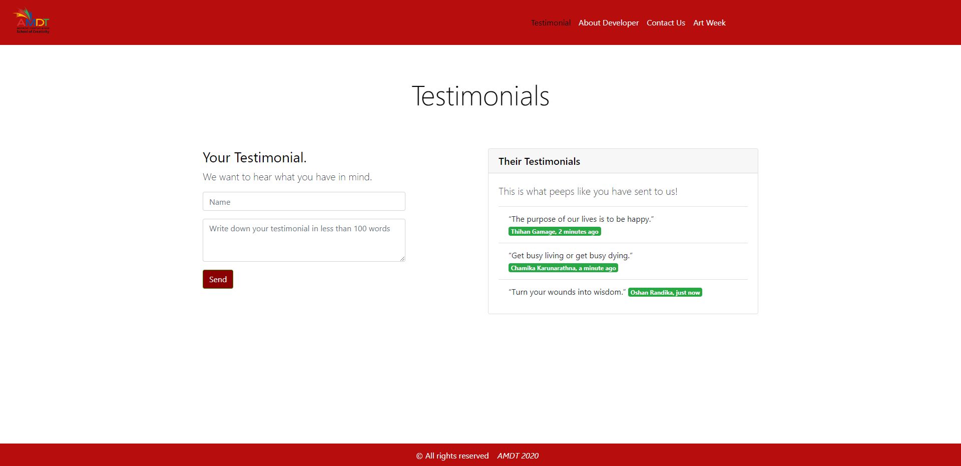
Testimonials Page
This is the Testimonials page, So if you have something creative in your mind drop it out so everybody can hear about it.

Slide 23
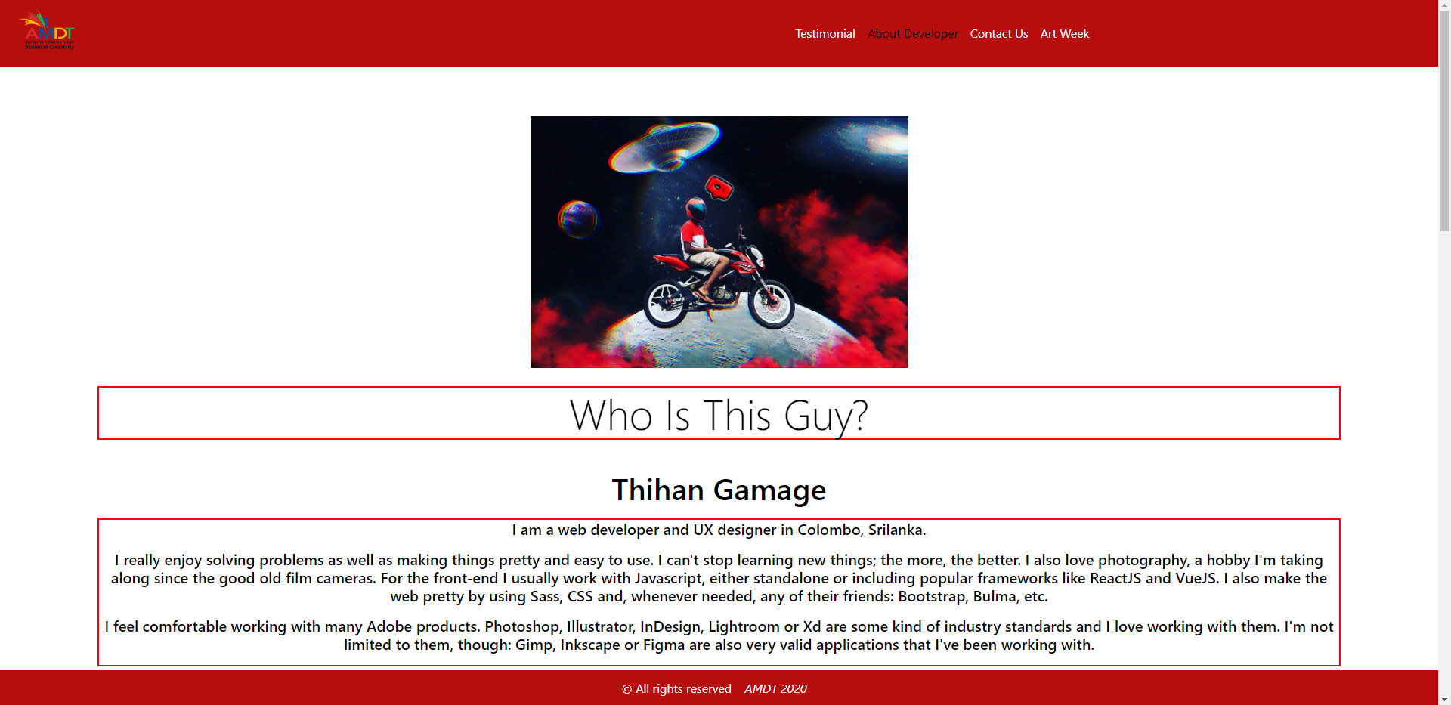
About Developer Page
This is the porfolio page, where we talk about the developer.

Slide 24
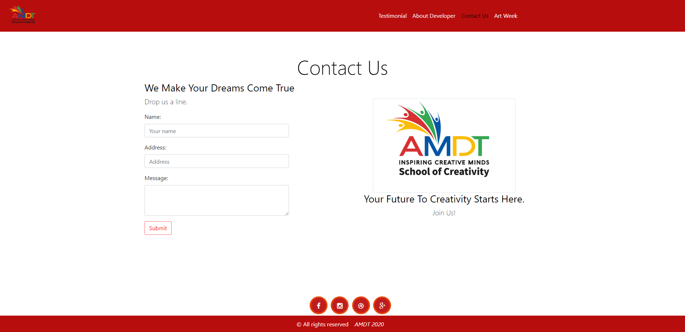
Contact Us Page
This is the contact page where you can contact AMDT for information,

Slide 25
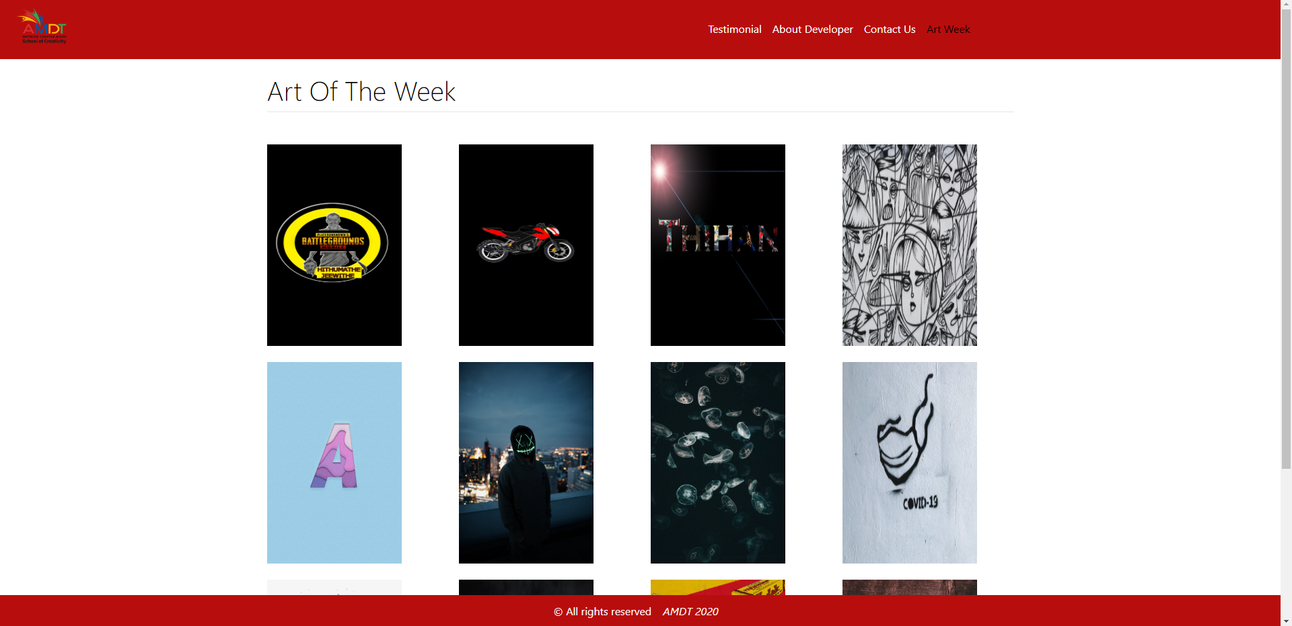
Art Week Page
This page contains the best art of students of the week.

Slide 26
References
Nielsen Norman Group. 2020. 10 Heuristics For User Interface Design: Article By Jakob Nielsen. [online] Available at: <https://www.nngroup.com/articles/ten-usability-heuristics/> [Accessed 17 June 2020].

